Slide 1




Urvi Pasad
Letter Recognition
Term 4: Machine Learning Intermediate
Batch : October 19 Cohort

Slide 2
Problem Statement
The objective is to identify each of a large number of black-and-white rectangular pixel displays as one of the 26 capital letters in the English alphabet. The character images were based on 20 different fonts and each letter within these 20 fonts was randomly distorted to produce a file of 20,000 unique stimuli. Each stimulus was converted into 16 primitive numerical attributes (statistical moments and edge counts) which were then scaled to fit into a range of integer values from 0 through 15. We typically train on the first 16000 items and then use the resulting model to predict the letter category for the remaining 4000.

Slide 3
GOAL
Our goal of this Case study is to identify the alphabet correctly from the 26 Alphabets.
The goal of this ML modeling is to minimize both False Positive and False Negative. Hence the Accuracy or F1 score should be considered to select the right algorithm

Slide 4

Data Description
Data is collected from below site. https://archive.ics.uci.edu/ml/datasets/Letter+Recognition
There are 20000 rows and 18 columns
17 columns are of type Integer, 1 target column which is Object type

Slide 5
Data Preprocessing
1
Remove Id Column
3
Check for Correlation
4
Feature Extraction/Train Test Split
2
Check for Data Imbalance

Slide 6
Data Modeling
Naïve Bayes
KNN
Random Forest
SVM
Principal Component Analysis

Slide 7
Model Evaluation- GRIDSEARCHCV
Model | Best Score | Best Parameters
Naive Bayes - GaussianNB | 0.645417 | { }
SVC | 0.954792 | {'C': 40, 'kernel': 'rbf'}
Random Forest | 0.927917 | {'n_estimators': 30}
KNN | 0.929896
BEST MODEL : SVC with Score .9547

Slide 8
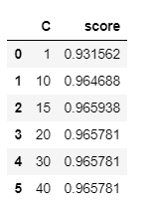
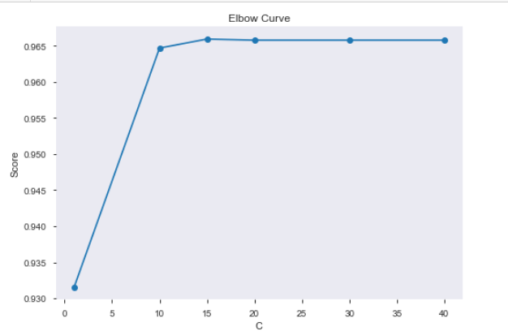
SVC Model – Choose Best C
Choose best C value to avoid Overfitting or underfitting
BEST C = 10
Run Time: 24.45 ms

Slide 9
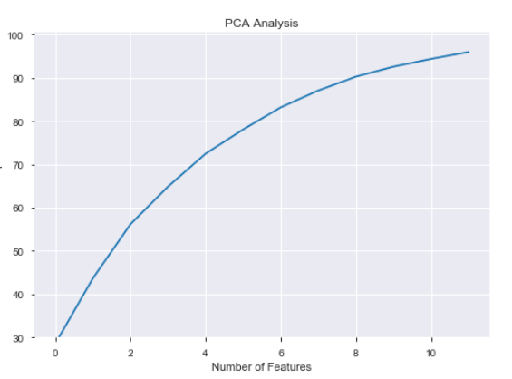
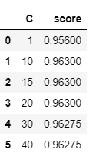
PCA – For SVC Model Use PCA to reduce dimensionality and check if we can improve Performance of our model
Choose best C value to avoid Overfitting or underfitting
BEST C = 10
Run Time: 47.16 ms

Slide 10
Conclusion
SVC is the Best model with 96% accuracy on Test Data with C= 10

Slide 11
Thank You

